Slide 1

Amit Banerjee Sr. Program Manager Microsoft Database Systems
Upgrade SQL Server Like a Ninja

Slide 2
C:\Users\> whoami Known on Twitter as @banerjeeamit
An affair with SQL Server for nearly a decade
Was part of SQL Escalation Services and Premier Field Engineering team at Microsoft
Now a Sr. Program Manager on the Microsoft Database Systems team focusing on Performance and HADR
Speaker at SQL PASS 24HOP TechEd Virtual TechDays User Groups SQL Saturdays
Dabble around with supportability tools and have contributed to SQL Backup Simulator SQLDIAG/PSSDIAG Manager and SQL Nexus
Co-authored
“Professional SQL Server 2012: Internals and Troubleshooting”
“Pro SQL Server on Azure”
Own TroubleshootingSQL.com

Slide 3
SQL Server 2017 Theme & Focus
Choice
Windows
Linux
Azure
Docker (MacOS)
Intelligent
Adaptive QP
Automatic Tuning
Intelligent Diagnostics
R
Python
Graph
Migration
DMA
DMS
DEA
SSMA
Customer & Community Driven Investments

Slide 4
SQL Server 2017 Theme & Focus
Choice
Windows
Linux
Azure
Docker (MacOS)
Intelligent
Adaptive QP
Automatic Tuning
Intelligent Diagnostics
R
Python
Graph
Migration
DMA
DMS
DEA
SSMA

Slide 5
An Upgrade Journey
Discover
Application Remediation
Perform Tests
Assess
Migrate
Convert
Optimize
Sync Data
Cutover

Slide 6

After this session, you will know…..
How to upgrade like a
NINJA
Notes:
2 mins

Slide 7
What’s next after SQL Server 2017?
Customer & Community Driven
Faster Cadence
You can expect that we aren’t returning to a slower release cycle
Easy Migration (Lift and Shift)
Seamless migration and modernization to upgrade/migrate to latest release of SQL Server
Cloud First
Azure SQL DB service best practices will continue to flow into SQL Server – what we fix in the service, we’ll want to port to SQL Server as well
Adaptive
While not every complexity can be addressed, we will look to minimize and mitigate through adaptive mechanisms (feedback loops, sampling, adaptive switches based on runtime conditions)

Slide 8
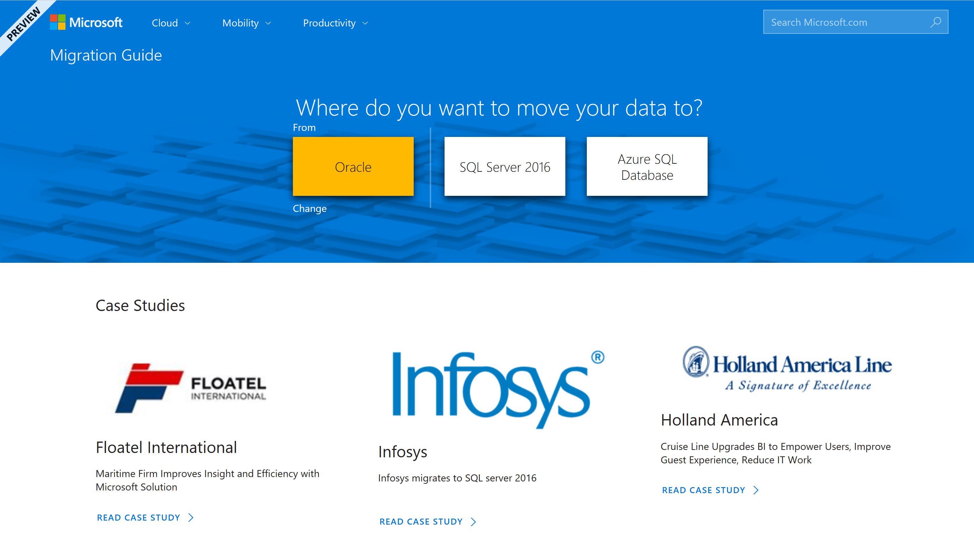
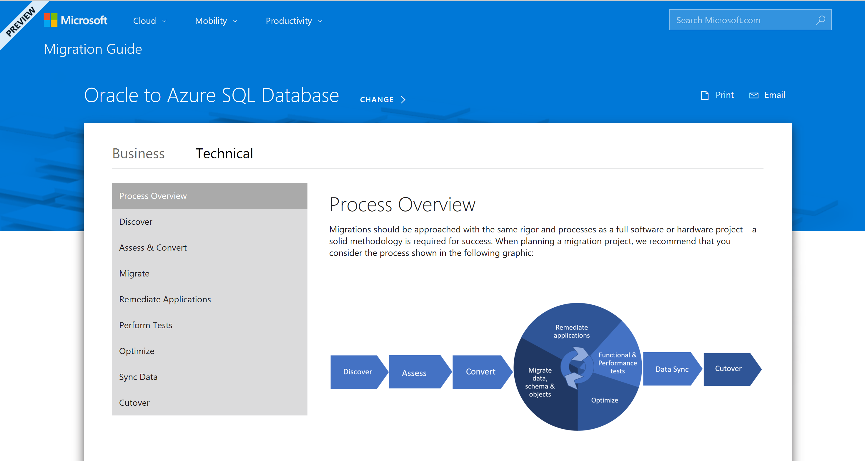
Database Migration Guide
One-stop-shop guide for database migrations
Step-by-step guidance from by source and target
Recommended Partners, Customer case studies
http://datamigration.microsoft.com

Slide 9


Migration Tools & Services
Assess
Migrate
Data Migration Assistant
Rich assessments at scale
Feature recommendations
Schema conversions
Azure Database Migration Service
MS and non-MS source support
Built for scale and reliability
Built with enterprise security and privacy
Notes:
DMA –Latest and greatest knowledge base of all SQL versions. This helps with assessing and planning.
DMS – Newest offering, Azure service that helps you move your on-prem DBs to Azure at scale.

Slide 10
Azure Database Migration Service
Fully managed database migration service for both operational databases and data warehouses
Supports minimal down time migrations
Supports both homogeneous and heterogeneous source-target pairs
Assessments via Data Migration Assistant
SQLDB or
SQL VM
SQL DB
Oracle
MySQL
…
SQL Server | Azure SQL VM, Azure SQL Database & Managed Instance
MySQL | Azure Database for MySQL
PostgreSQL | Azure Database for PostgreSQL
Oracle, … | Azure SQL Database & Managed Instance
Netezza, … | Azure SQL Data Warehouse
SQL Server
SQL
Reliable & Seamless migrations to the Cloud

Slide 11
DEMO

Slide 12
What’s next after SQL Server 2017?
Customer & Community Driven
Faster Cadence
You can expect that we aren’t returning to a slower release cycle
Easy Migration (Lift and Shift)
Seamless migration and modernization to upgrade/migrate to latest release of SQL Server
Cloud First
Azure SQL DB service best practices will continue to flow into SQL Server – what we fix in the service, we’ll want to port to SQL Server as well
Adaptive
While not every complexity can be addressed, we will look to minimize and mitigate through adaptive mechanisms (feedback loops, sampling, adaptive switches based on runtime conditions)

Slide 13
Bookmarks
SQL Server Tiger Team Blog
Tiger Toolbox GitHub
SQL Server Release Blog
BP Check
SQL Server Standards Support
Trace Flags
SQL Server Support lifecycle
SQL Server Updates
Twitter
http://aka.ms/sqlserverteam
http://aka.ms/tigertoolbox
http://aka.ms/sqlreleases
http://aka.ms/bpcheck
http://aka.ms/sqlstandards
http://aka.ms/traceflags
http://aka.ms/sqllifecycle
http://aka.ms/sqlupdates
@mssqltiger

Slide 14















Thank you Sponsors!

